Slide 1


MATH 242
Analytic Geometry and Calculus B
Section 12
Instructor: Jacob Wyngaard
Volume, Disk Method, Washer Method

Slide 2
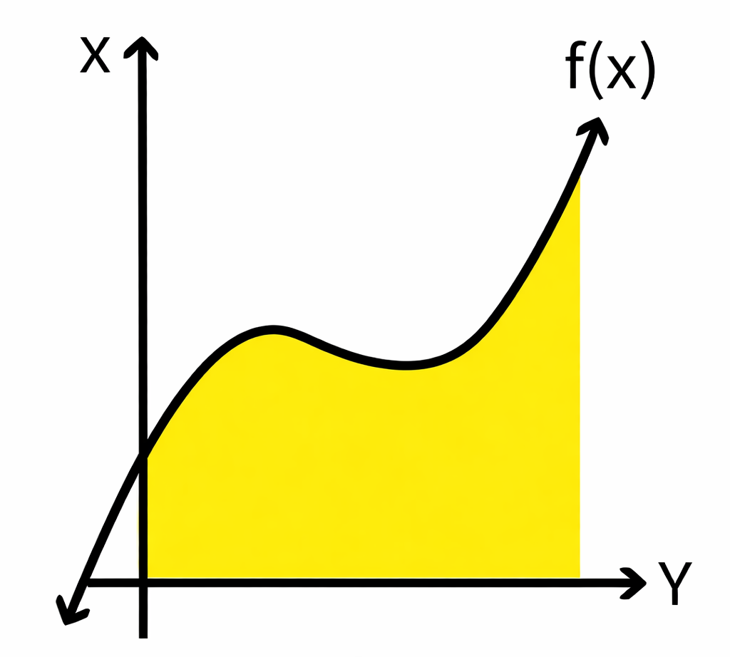
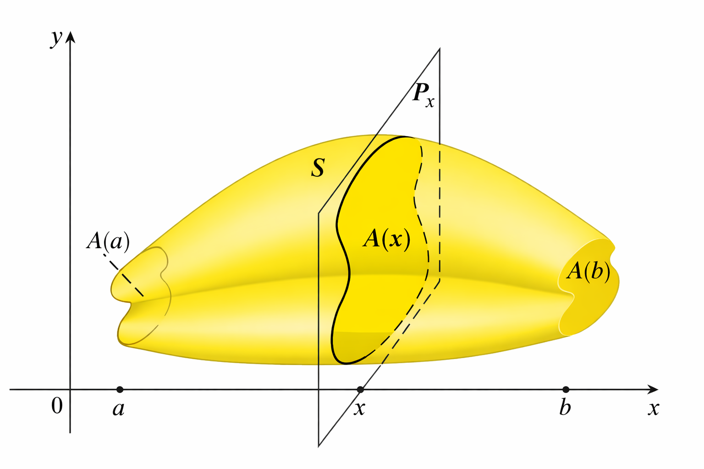
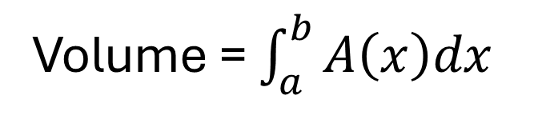




Background
  To find the area under a curve, we integrate the height over the length
  To find a volume, we can integrate the cross-sectional area over the length
$$y$$
$$h\left(x\right)$$
$$x$$
Area = $\int_{a}^{b}{h\left(x\right)dx}$
Volume = $\int_{a}^{b}{A\left(x\right)dx}$

Slide 3
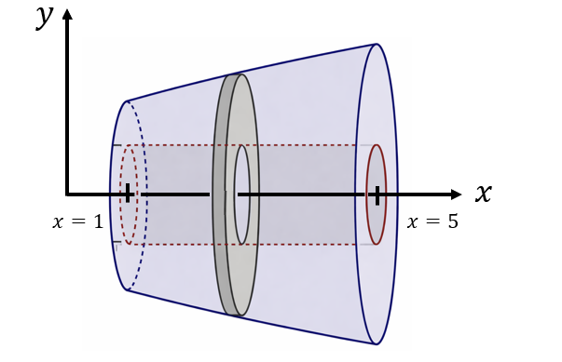
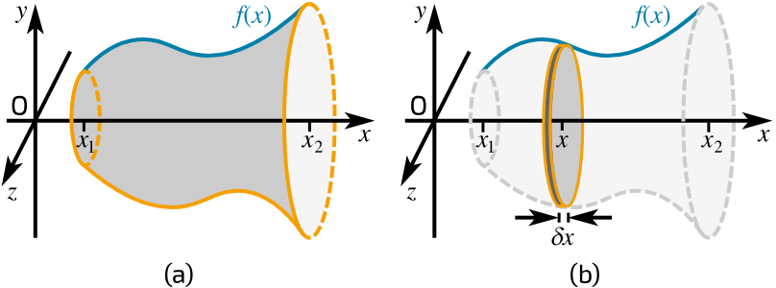
Volumes of Interest
  In Calculus B, we are interested in volumes generated by rotating two dimensional regions about an axis

Slide 4

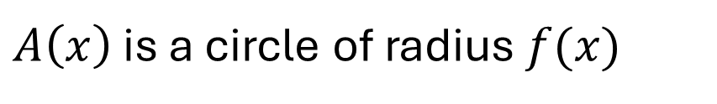
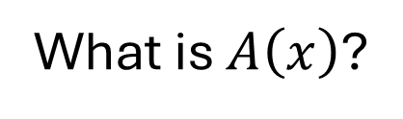
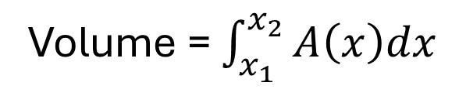
Disk Method
  We can use the disk method when the rotated region is bounded by the axis of rotation
  Going back to our volume formula,
Volume = $\int_{x_{1}}^{x_{2}}{A\left(x\right)dx}$
What is $A\left(x\right)$?
$$f(x)$$
$A\left(x\right)$ is a circle of radius $f(x)$
In this example, the axis of rotation is the x-axis

Slide 5
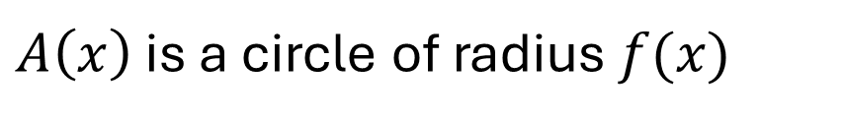
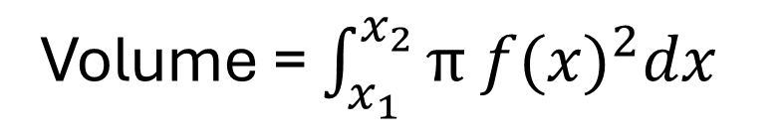
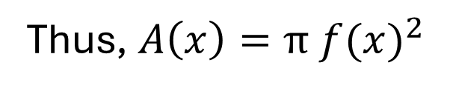

Disk Method
  We can use the disk method when the rotated region is bounded by the axis of rotation
  Going back to our volume formula,
Volume = $\int_{x_{1}}^{x_{2}}{A\left(x\right)dx}$
$A\left(x\right)$ is a circle of radius $f(x)$
Thus, $A\left(x\right)=π {f(x)}^{2}$
Volume = $\int_{x_{1}}^{x_{2}}{π {f(x)}^{2}dx}$
In this example, the axis of rotation is the x-axis

Slide 6



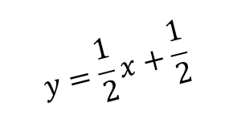



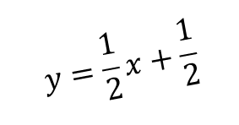




Washer Method
  We can use the washer method when the rotated region is not bounded by the axis of rotation
$$y$$
$$y=\frac{1}{2}x+\frac{1}{2}$$
$$y=\frac{1}{2}x+\frac{1}{2}$$
$$y=3$$
$$y=3$$
$$y=2$$
$$y=2$$
$$y=1$$
$$y=1$$
$$x$$
$$x=1$$
$$x=5$$
In this example, the axis of rotation is the x-axis

Slide 7



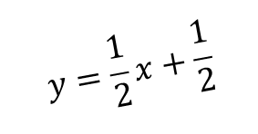




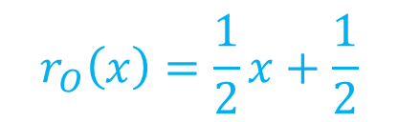



Washer Method
  For the washer method, we have to identify an inner radius and an outer radius
  The inner radius ($r_{I}$) is the closest distance between the region and the axis of rotation
  The outer radius ($r_{O}$) is the furthest distance between the region and the axis of rotation
$$y$$
$$y=\frac{1}{2}x+\frac{1}{2}$$
$$r_{I}\left(x\right)=1$$
$$y=3$$
$$y=2$$
$$r_{O}$$
$$r_{O}\left(x\right)=\frac{1}{2}x+\frac{1}{2}$$
$$y=1$$
$$r_{I}$$
$$x$$
$$x=1$$
$$x=5$$
In this example, the axis of rotation is the x-axis

Slide 8







Washer Method
  To compute the cross-sectional area, we subtract area of the circle formed by the inner radius from the area of the circle formed by the outer radius
$$y=3$$
$$y=2$$
$$r_{O}$$
$$y=1$$
=
-
$$r_{I}$$
Cross-Sectional Area
$${{π r}_{O}}^{2}$$
$${{π r}_{I}}^{2}$$

Slide 9


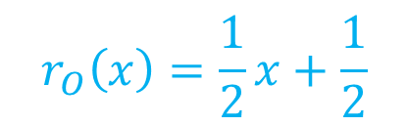
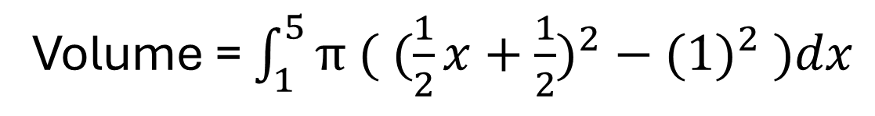
Washer Method
  To compute the cross-sectional area, we subtract area of the circle formed by the inner radius from the area of the circle formed by the outer radius
Volume = $\int_{1}^{5}{A\left(x\right)dx}$
$$y=3$$
$$y=2$$
$$A\left(x\right)={{π r}_{O}(x)}^{2}−{{π r}_{I}(x)}^{2}$$
$$y=1$$
$$r_{O}\left(x\right)=\frac{1}{2}x+\frac{1}{2}$$
$$r_{I}\left(x\right)=1$$
Volume = $\int_{1}^{5}{π ( ({\frac{1}{2}x+\frac{1}{2})}^{2}−({1)}^{2} )dx}$

